Slide 1
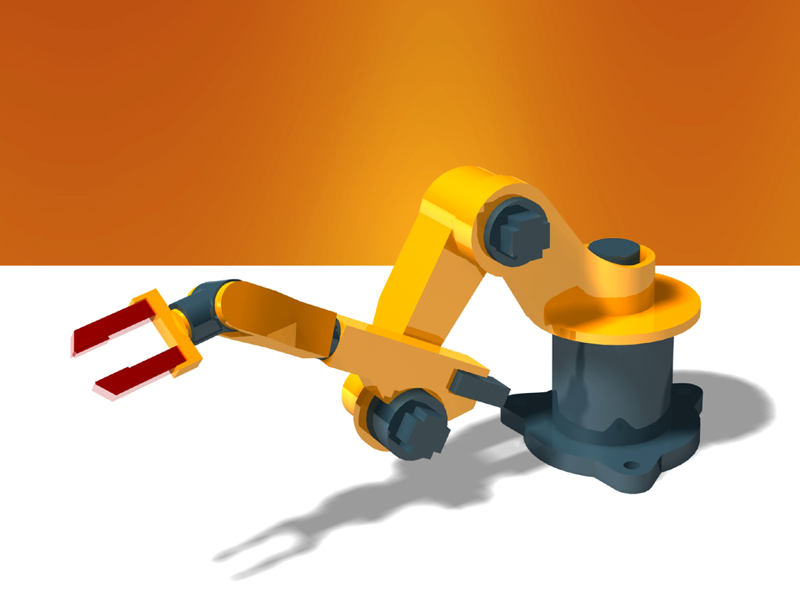
Applications of Graph Theory in Robotics: Riemannian Motion Policies
Anirudh Chari & Atharva Gawde

Slide 2

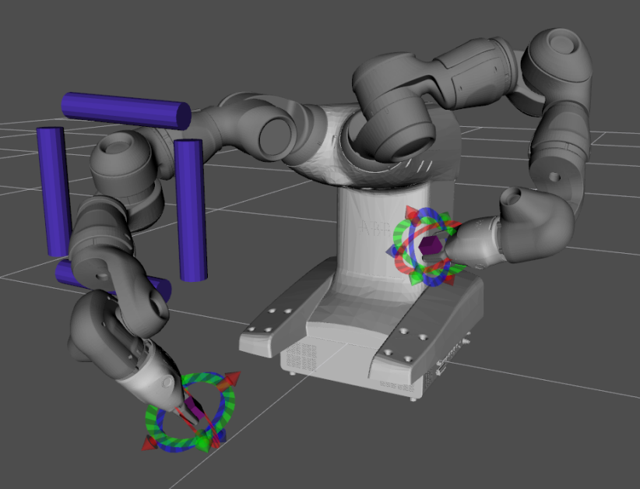
Introduction
First proposed in 2018 by researchers at Nvidia
Second-order modular motion generation system (f : x, ẋ → ẍ)
Seamlessly integrate and dynamically prioritize various potentially conflicting tasks
Geometrically consistent and provably optimal motion

Slide 3
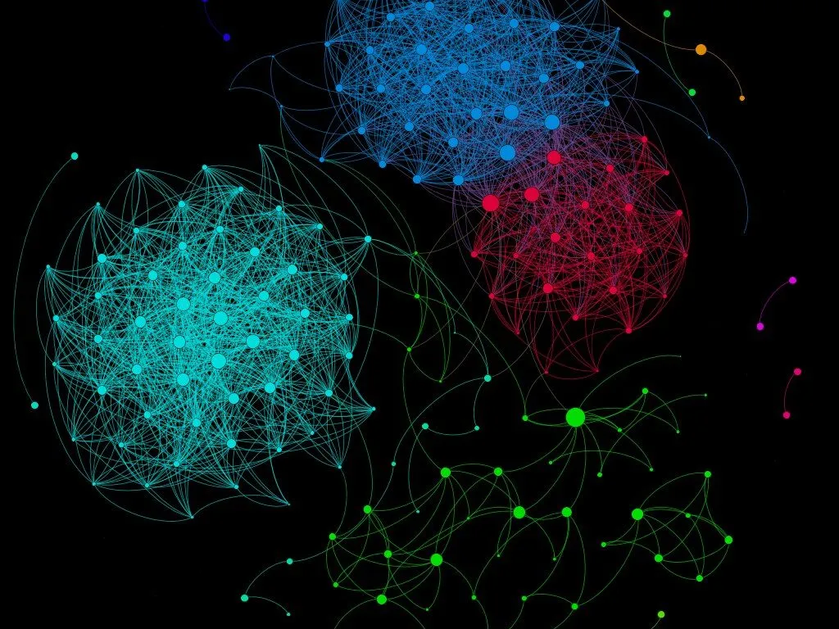

Background: Graph Theory
Vertices & Edges
Directed/Undirected
Cyclic/Acyclic
Trees & Polytrees

Slide 4
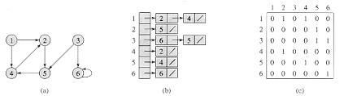
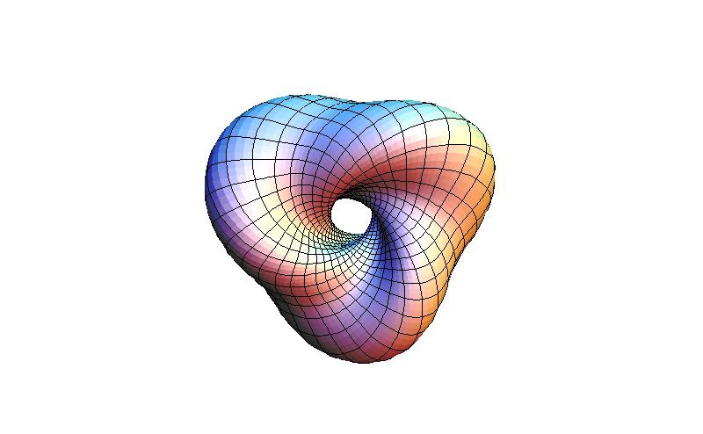
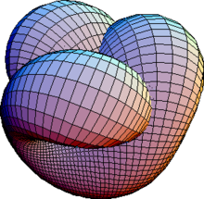
Background: Topology
Riemannian Manifolds
Adjacency Lists
Adjacency Matrices

Slide 5
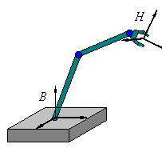
Background: Transformations
Configuration space (q₀,q₁) is coordinate system for robot’s overall motion
Hard to model motion algorithms for a specific tasks using configuration space coordinates
Linear transformation allows us to “shift” entire plane to align with task
Can translate between configuration space and task spaces using task map: φ(q₀,q₁) → (x₀,x₁)

Slide 6
Background: Transformations

Slide 7
Background: Policy Structure
Input: Position (x), Velocity (ẋ)
Output: Acceleration (ẍ), Inertia (M)
Inspired by F = ma
Computes desired acceleration to accomplish task and current importance of task
M enables dynamic prioritization
Runs in task space at each timestep

Slide 8
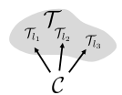
Background: The RMP Tree
Root node C is configuration node
Each leaf node T_{i} is a task node
Process:
C receives latest (q, q̇)
Pushforward: Propagation to each T_{i}, task map applied
Each T_{i} computes (ẍ, M) in task space
Pullback: Propagation back to C, task map reversed
C computes and outputs acceleration

Slide 9
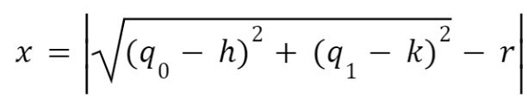
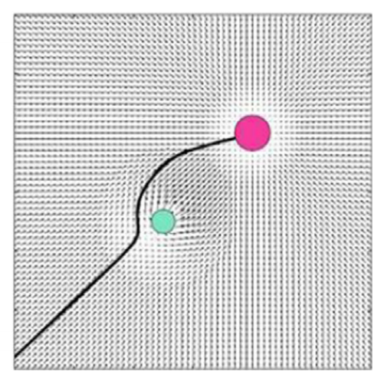
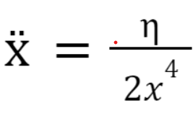
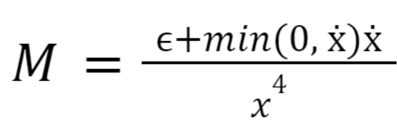
Examples: Collision Avoidance
Input: Position (h, k), radius r of obstacle to avoid
Task map:
Acceleration:
Inertia:
Acts like a repelling magnetic field around obstacle

Slide 10
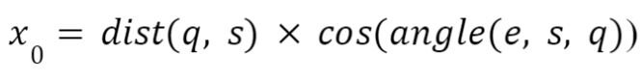
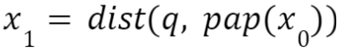
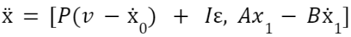
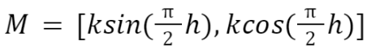
Examples: Path Following
Input: Some path to follow
Task Map:
Acceleration:
Inertia:
Acts like a spring connecting robot to projected point along path

Slide 11
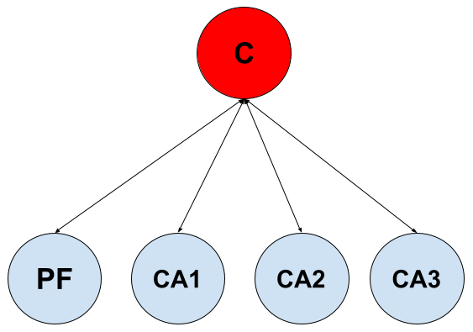
Demonstration: Structure
Mobile robot simulation developed in Java using RMPFlow framework
Randomized environment with start position, goal position, and n obstacles

Slide 12
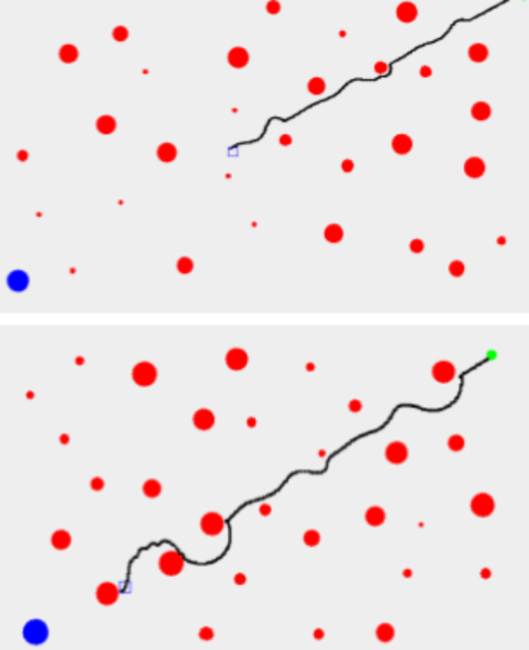
Demonstration: Results
Successful task integration: Always circumvents obstacles in direction with least displacement from path
Excellent maneuverability: 100 cm² robot only requires ~50cm between obstacles for 30 obstacles
Fast, safe, and optimal: Reached goal using coherent motion and without collision or hesitation in every trial performed

Slide 13
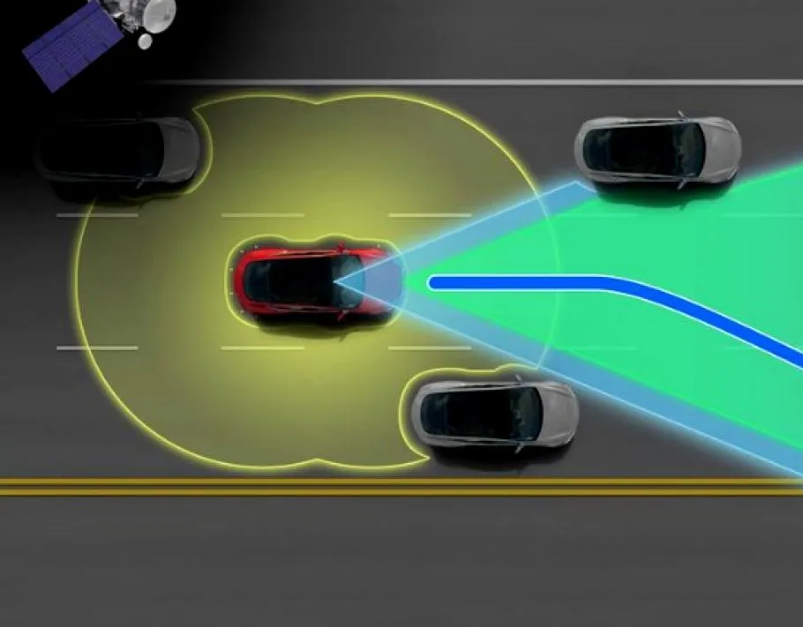
Applications
Applicable to any autonomous system requiring dynamic prioritization of various tasks
Ex: Self-driving car
Path following (navigation)
Collision avoidance
Lane centering
Motion fluidity (for passenger comfort)
Motion predictability (for other drivers)
Fuel efficiency
Speed limit compliance
etc.

